Slide 1
Viruses

Slide 2
archaeal
Bacterial, mammalian

Slide 3
Table 1. Some types of viruses, classified by nucleic acid (the Baltimore system). There are seven classes in the Baltimore system. The genetic material can be double-stranded (ds) or single-stranded (ss). Single-stranded nucleic acids can be present in viruses as the positive strand (+) or the negative strand (-). Some of this genomic material is first transcribed to DNA by reverse transcriptase (RT). Genome size is measured in thousands of base pairs (kbp) or thousands of bases (kb) in the case of single-stranded nucleic acid viruses. The examples given here are biased towards those causing diseases in humans or economically-important organisms. Data from (Wagner et al. 2008). See also the Universal Virus Database of the International Committee on Taxonomy of Viruses (www.ictvdb.org).
Type | Genetic material | Example Family | Example virus | Genome Size (kbp or kb) | Host
I | dsDNA | Myoviridae | T4 | 39-169 | Bacteria, Archaea, algae
II | (+) ssDNA | Parvoviridae | Aleutian mink disease (AMDV) | 4-6 | Vertebrates, invertebrates
III | dsRNA | Reoviridae | Rotavirus A | 19-32 | Vertebrates, invertebrates, plants
IV | (+)ssRNA | Picornaviridae | Hepatitis C virus | 7-8 | Vertebrates
VI | ssRNA-RT | Retroviridae | HIV | 7-12 | Vertebrates

Slide 4
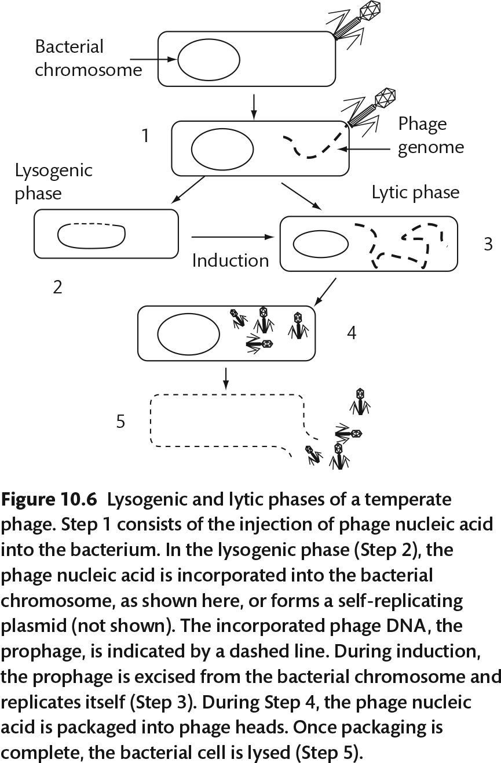

Slide 5
Mitomycin C

Slide 6
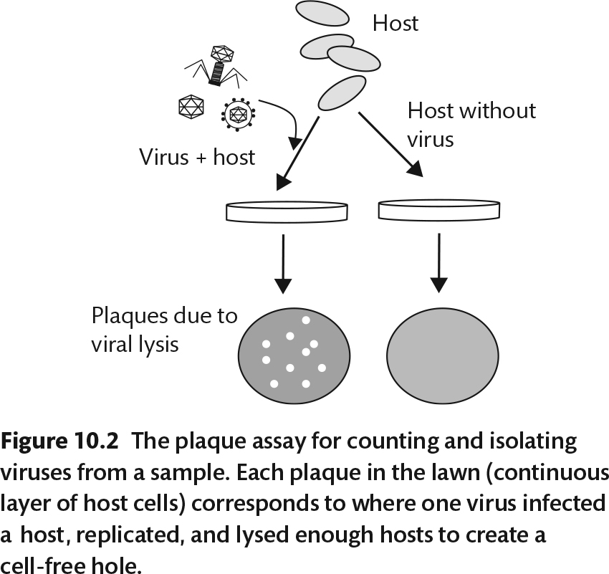
This requires that the bacterial host be known and grown in lab!

Slide 8
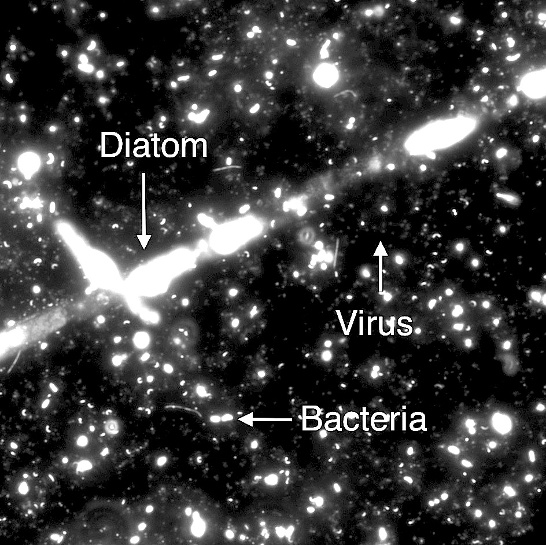

Slide 9
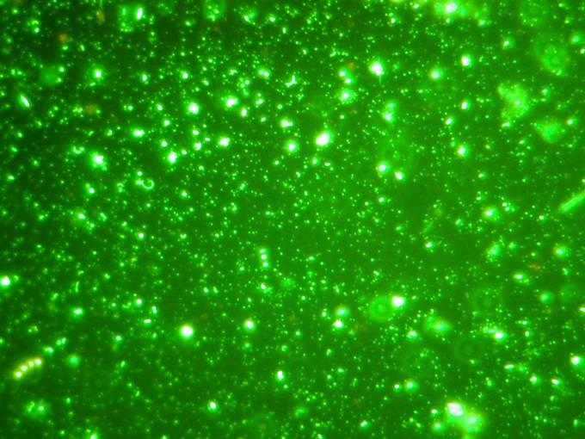
Noble, R.T., and J.A. Fuhrman. 1998. Aquat. Microb. Ecol. 14: 113-118

Slide 10
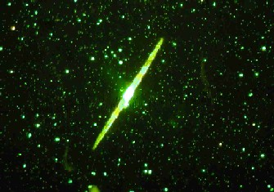
diatom
bacteria
Viruses (smallest particles)

Slide 11
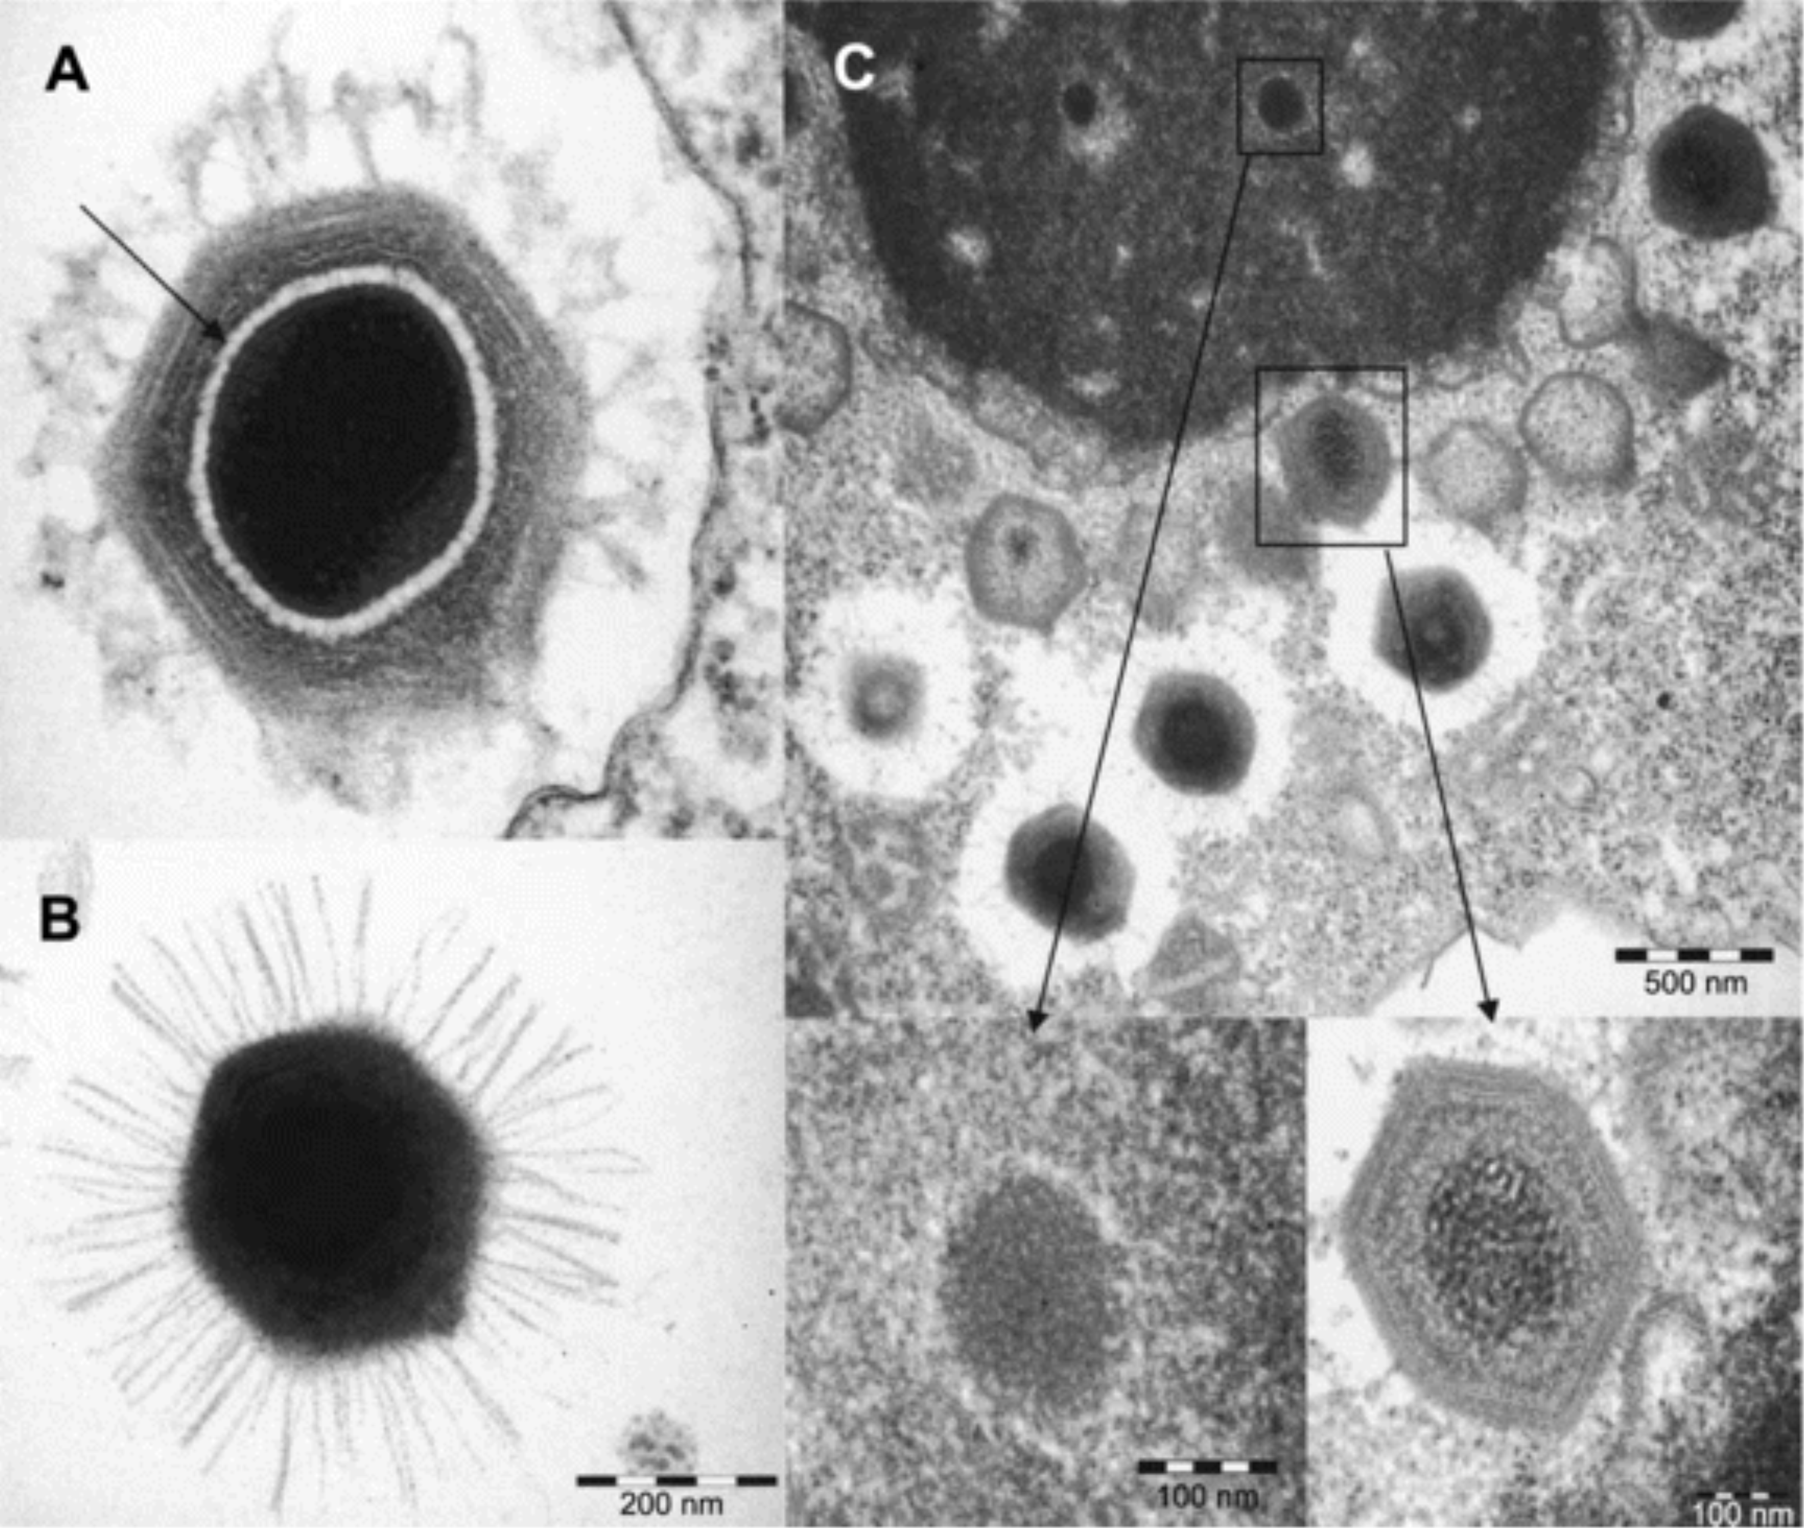
From: The Discovery and Characterization of Mimivirus, the Largest Known Virus and Putative Pneumonia Agent
Clin Infect Dis. 2007;45(1):95-102. doi:10.1086/518608
Clin Infect Dis | © 2007 by the Infectious Diseases Society of America

Slide 12
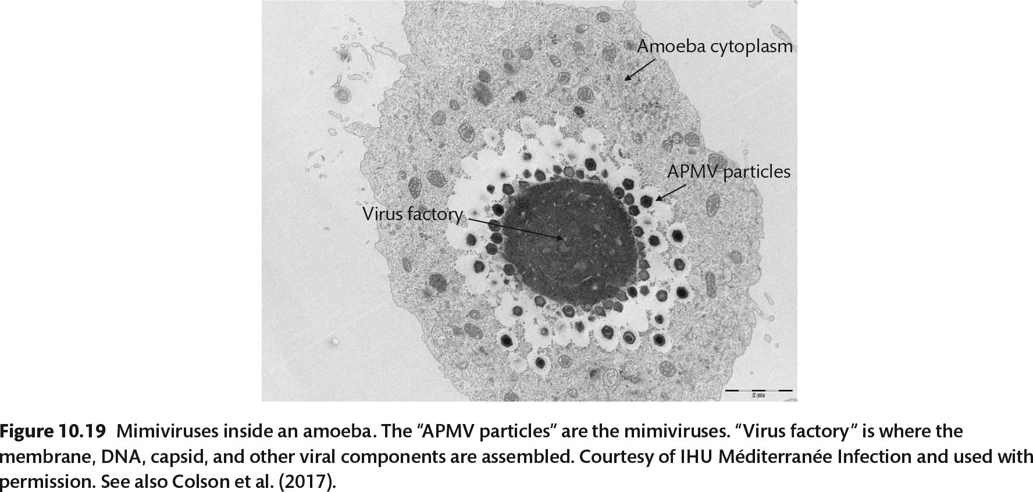
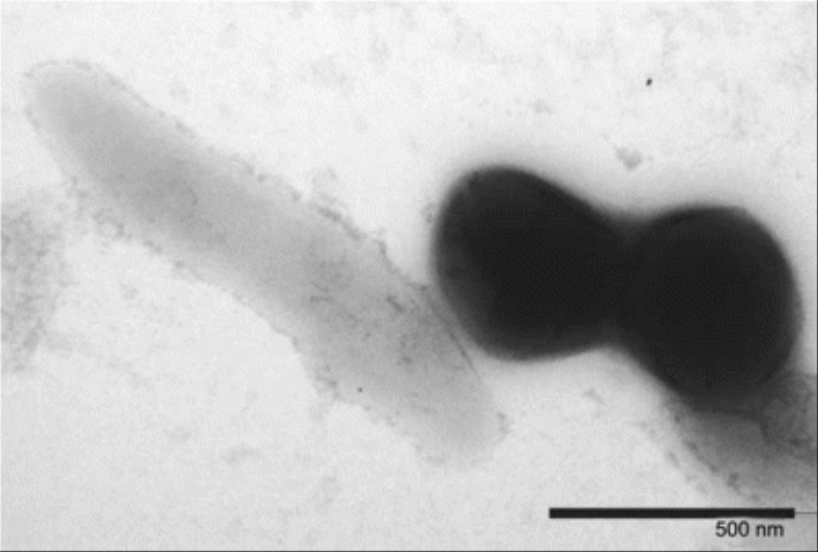
Figure 3 Negative-staining electronic microscopy showing Mimivirus (right) and Tropheryma whipplei bacillus (left; bar, 500 nm).
From: The Discovery and Characterization of Mimivirus, the Largest Known Virus and Putative Pneumonia Agent
Clin Infect Dis. 2007;45(1):95-102. doi:10.1086/518608
Clin Infect Dis | © 2007 by the Infectious Diseases Society of America
Notes:
Figure 3 Negative-staining electronic microscopy showing Mimivirus (right) and Tropheryma whipplei bacillus (left; bar, 500 nm).
12

Slide 13
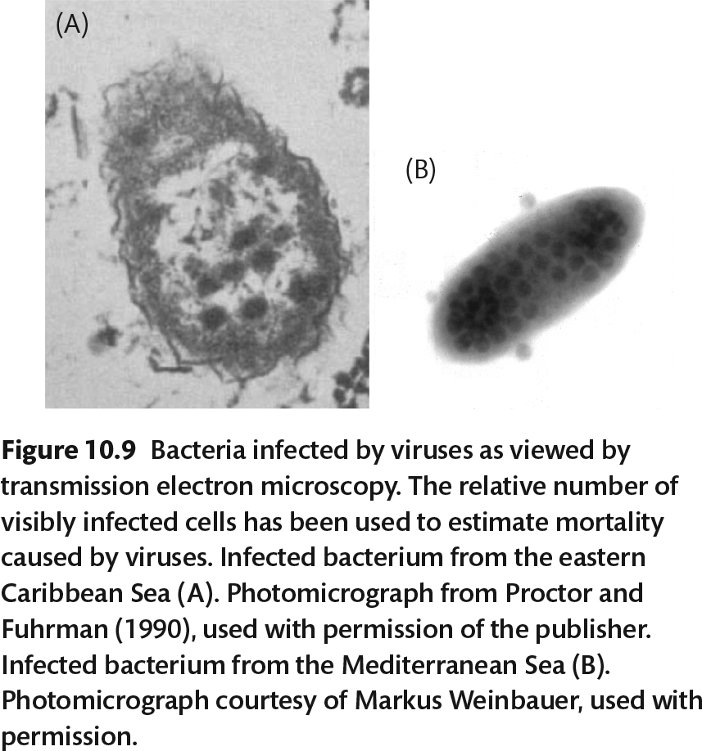

Slide 14
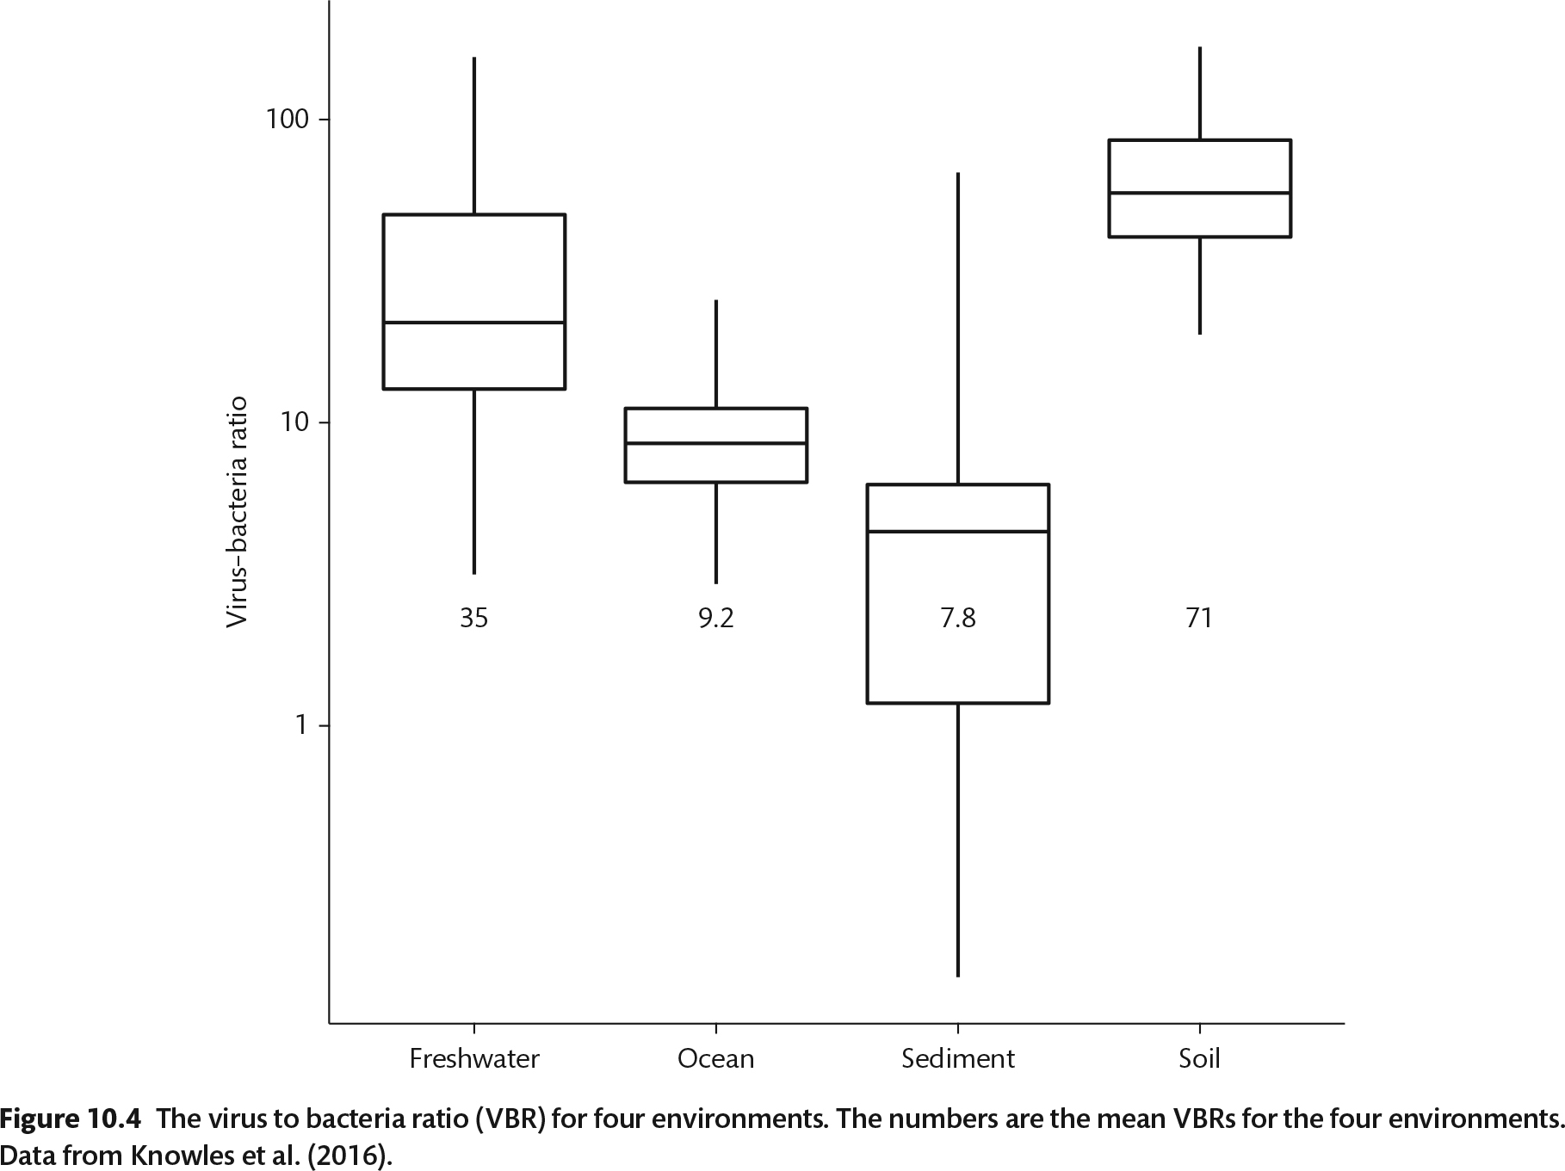

Slide 15
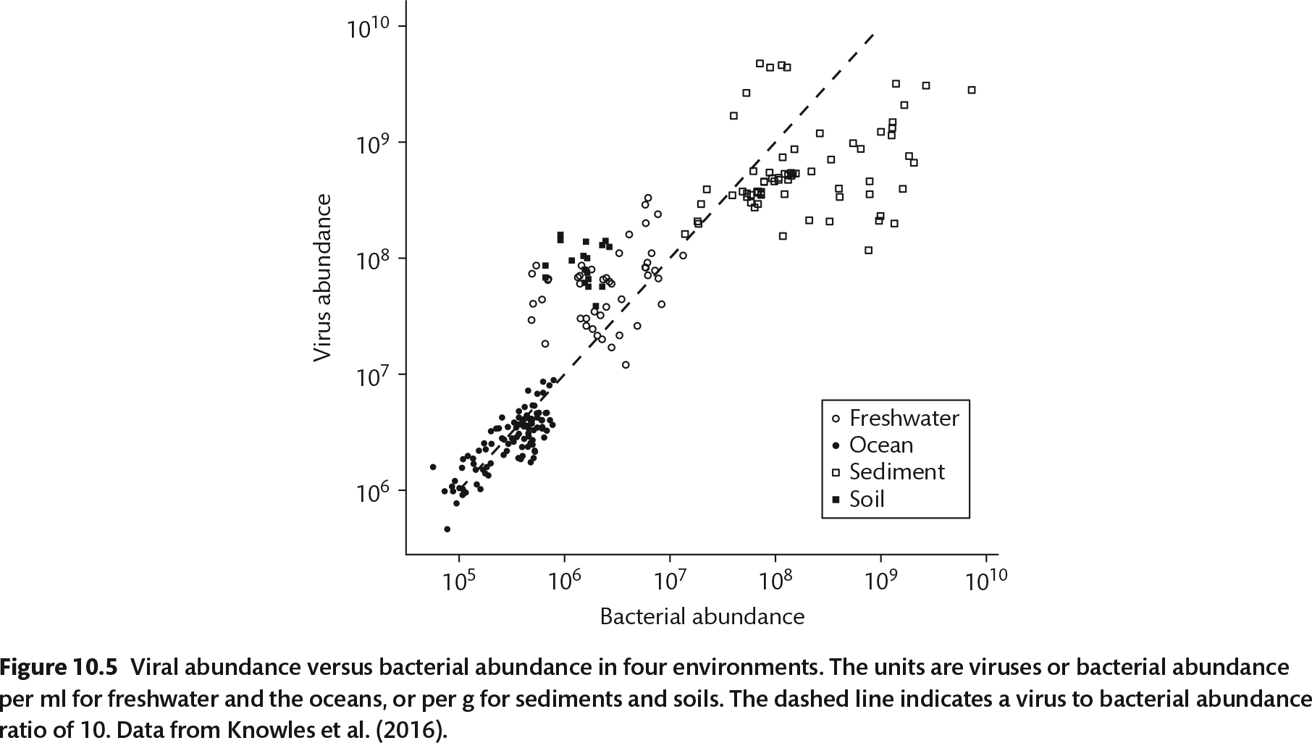

Slide 16
How are marine viruses found?
If host is unknown, cannot plate for plaques
Microscopy: electron microscopy
Bioinformatics:
  Filter water onto filters with 0.01 micron pore size
  Collect viral DNA/RNA, extract and sequence
  Computationally assemble into viral genomes
  Who is the host? CRISPR can help

Slide 17
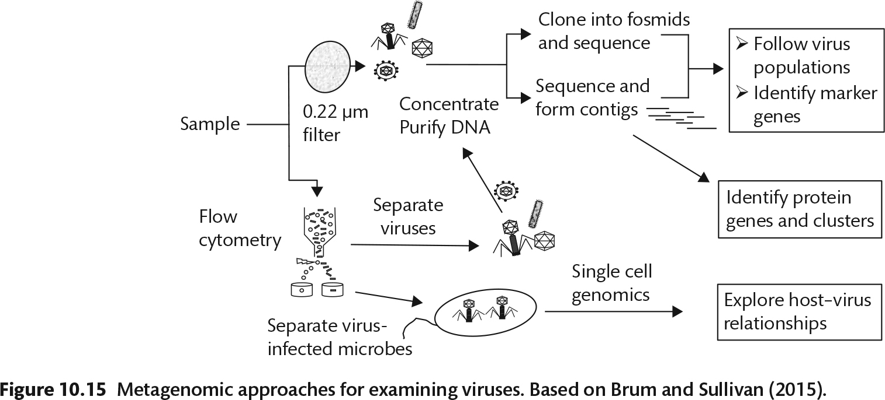

Slide 18
Table 2. Number of viruses and bacteria in some natural environments, per milliliter for the aquatic habitats or per gram for soils and sediments. “Viruses:Bacteria” refers to the ratio of viral abundance to bacterial abundance. The aquatic data are from (Wommack and Colwell 2000), the soil data are from (Williamson et al. 2005) and the sediment data are from (Danovaro et al. 2008). See also (Srinivasiah et al. 2008).
Habitat |  |  | Number of viruses (10⁶ per ml or per g) | Virus: Bacteria
Freshwater | Lake Plußsee | Spring | 254 | 41
 | Quebec lakes | Summer | 110 | 23
 | Danube River | Entire Year | 12–61 | 2–17
Marine | Chesapeake Bay | Spring | 10 | 3.2
 | South California | Spring | 18 | 14.2
 | North Pacific | Spring-fall | 1.4-40 | 2.3–18
Sediments | Lake Gilbert, Quebec | 2-14 meters | 720–20300 | 0.8–25.7
 | Chesapeake Bay | 1-17 meters | 340–810 | 57
 | Sagami Bay, Japan | 1450 m | 290–2560 | 8.0–35.0
Soils | Silt loam | Corn field | 1100 | 2750
 | Loamy sand | Corn field | 870 | 3346
 | Silt loam | Forest | 2940 | 11
 | Piedmont wetland | Forest | 4170 | 12

Slide 19
Notes:
Mortality of bacteria in the water column – comes from grazing, but also from viruses. Form of control called “kill the winner”
How do you know cells are infected? Can see in TEM, but visible number is low b/c hard to see. Visible on in 10-20% of entire life cycle.
Based on visible calculations, 5-50% of mortality is from viruses, that is by calculating based on visible knowing that’s only 10-20% of time.

Slide 20
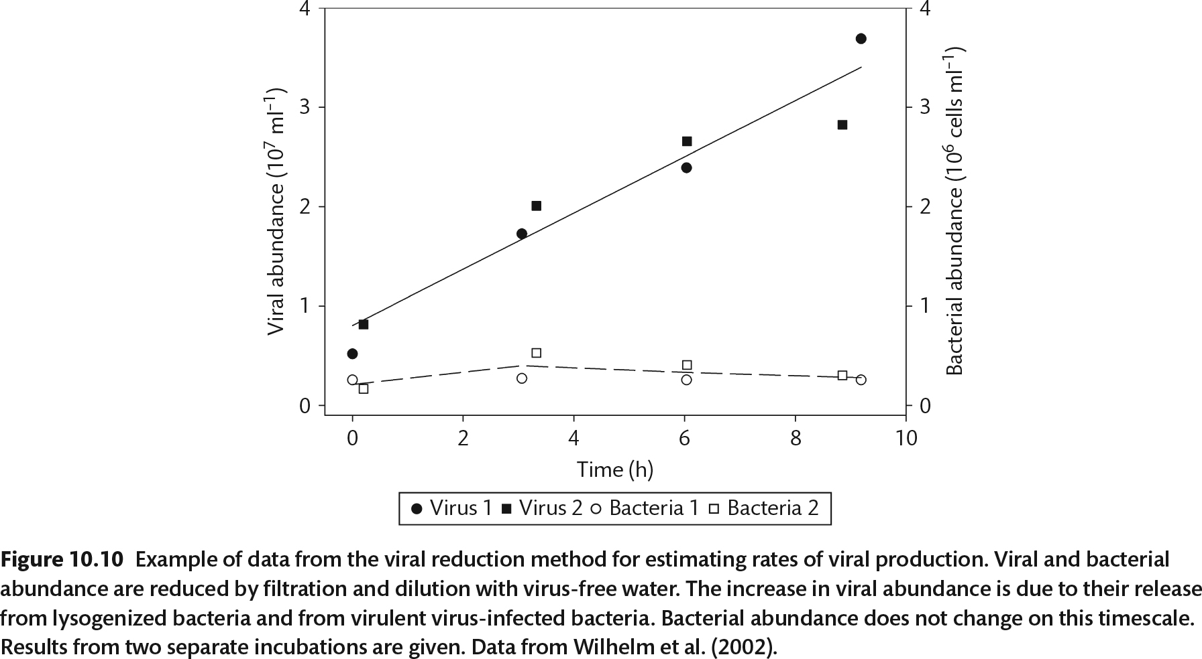
Notes:
Another method of determining mortality is viral reduction method
Filter viruses out of sample, then add the virus free water to a concentrated bacterial fraction. Count over time as bacteria lyse and let new viruses in to solution. Helpful to know burst size to back calculate. This method confirmed 50% mortality.
Viruses are more important in environment where protists can’t grow well, arctic sea ice, low pH, high salt,
Viruses may be very important in anoxic environments, where eukaryotic protists can’t exist!

Slide 21
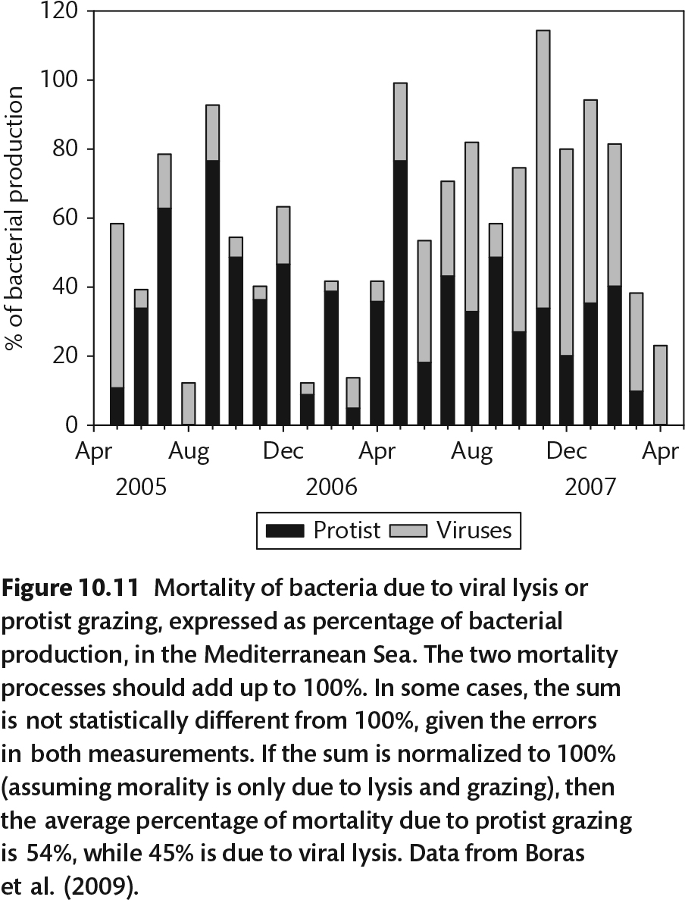

Slide 22
Notes:
Viruses have fast turnover, if bacterial grow on order of a day, viruses turnover every hour
How do viruses die? Sunlight breaks down viruses due to UV damage of DNA. Make superoxides.
Viruses can absorb to particles. Drying also inactivates them. High temp damages. For households, bleach works.

Slide 23
Notes:
Emiliania hyxleui bloom in North Sea, small viruses are filled circles, total are open circles, counted by TEM

Slide 24
Notes:
Viruses help activate the microbial loop. A grazer eating bacteria takes all the nutrients. Viral lysis releases them back into the environment.
Research suggests that bacterial growth is faster around viruses because they release so many nutrients

Slide 25
Notes:
Bacteria have defense against viruses. Small mutations can prevent attachment.
Keeping up resistance can have a fitness cost, making resistant cells grow slower. However they keep going if the sensitive ones are killed off. In this graph, the insensitive one doesn’t take over entirely because it is a bad competitor for carbon. The sensitive goes up and down and they coexist.
Reminder that viral attack is numbers game – virus kills host then has to go find another one.

Slide 26
Bacterial defense
Restriction-modification of DNA
Mutation of attachment site

Slide 27
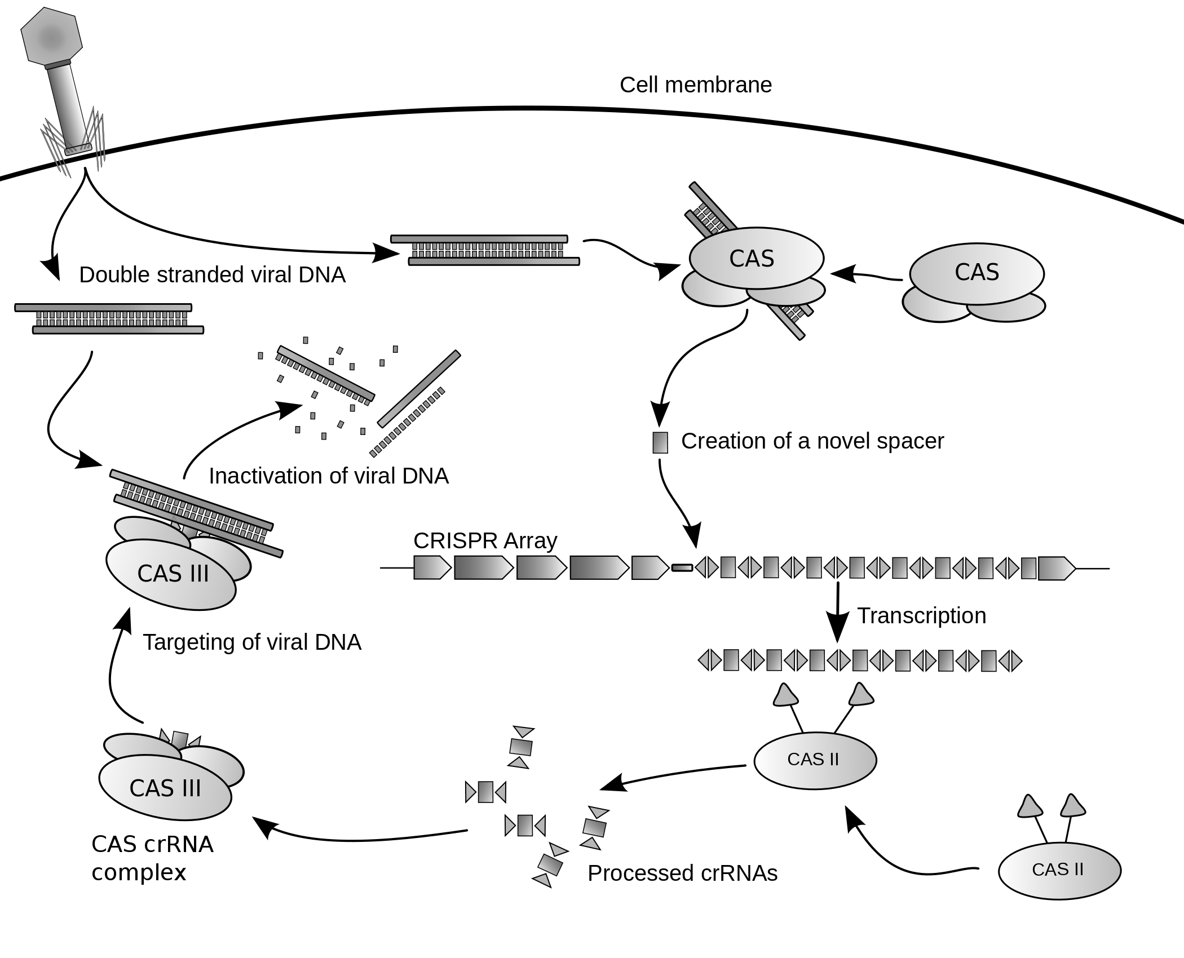
CRISPR – Cas Host Viral Defense
By James atmos - Own work, CC BY-SA 3.0, https://commons.wikimedia.org/w/index.php?curid=7821536
Notes:
Clustered Regularly Interspaced Short Palindromic Repeats

Slide 28
Fitness impact of resistance
Resistance can evolve quickly
Resistant host strains have shown up to 20% reduction in fitness compared to ancestral sensitive host strains

Slide 30
“Killing the winner” hypothesis: Viruses typically attack the most active members/dominant strains in an environment

Slide 31
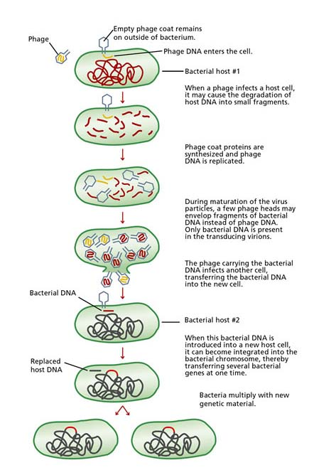
Viral DNA and capsids are replicated.
Some host DNA is also included during packaging of viral DNA into viral capsid,
The new virus carrying host DNA goes out into the environment and infects new host.
The genes from Host 1 may replace genes in Host 2 DNA.

Slide 32
Viruses can carry functional genes for biogeochemistry
Photosynthesis
  Seen in upper ocean with unicellular cyanos
Sulfur oxidation
  Seen in genomes of viruses in a hydrothermal plume
If viruses can kick-start host metabolism, their “life” gets easier

Slide 33
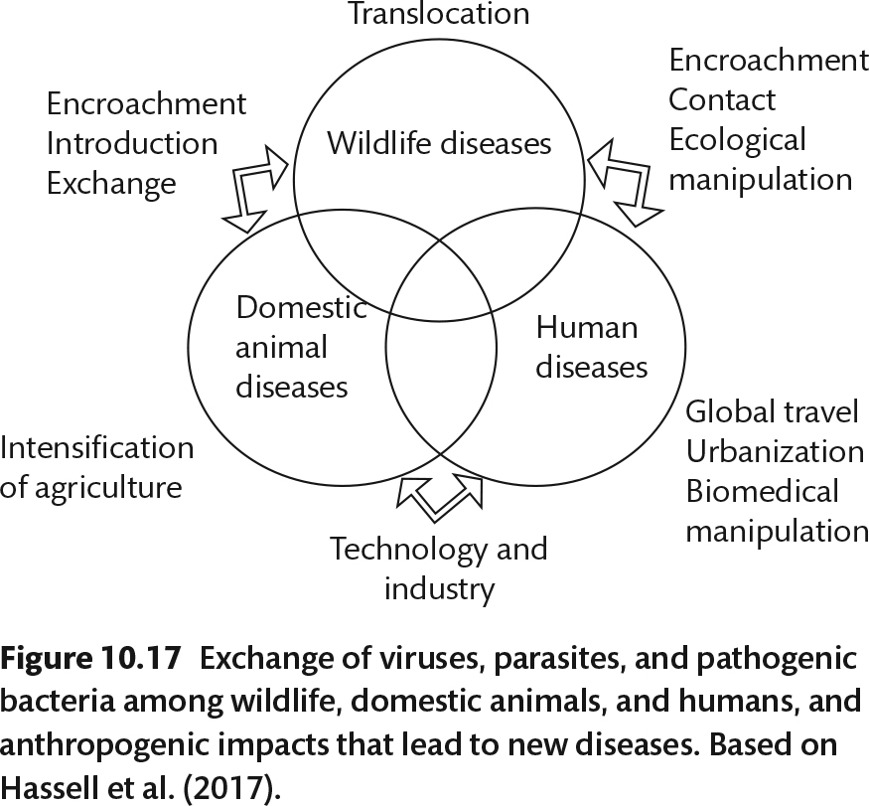
zoonotic

